Slide 1

Customer Sentiment Analysis. AliExpress Electrical Product Reviews.

Slide 2
Problem statement
In today’s digital age, e-commerce platforms must analyse large volumes of customer feedback to accurately understand product sentiment. This understanding is essential for making informed decisions about product improvements, marketing strategies, and customer satisfaction. Manual analysis of thousands of reviews is impractical and inefficient, highlighting the need for an automated analysis solution.

Slide 3
Objectives
The aim of this project is to perform sentiment analysis on the reviews to classify customer sentiments, which will assist the company in enhancing products features and customer experiences.

Slide 4
Dataset Story
Origin; Data scrapped from the website by Data Engineers
Features;
Username- Unique identifier for each customer signed up to the company
Location – Geographical distribution of customers who gave reviews
Total Review – Total reviews by each customer
Date of experience – The date the customer made the review
Content – Full text of customer review, providing detailed feedback
Rating – Number of stars given by each customer.

Slide 5
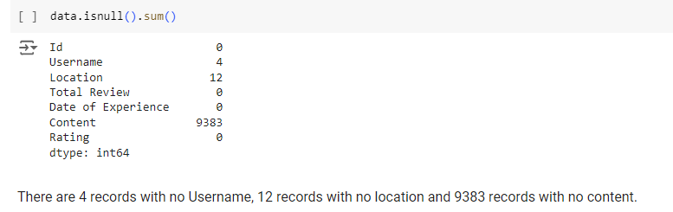
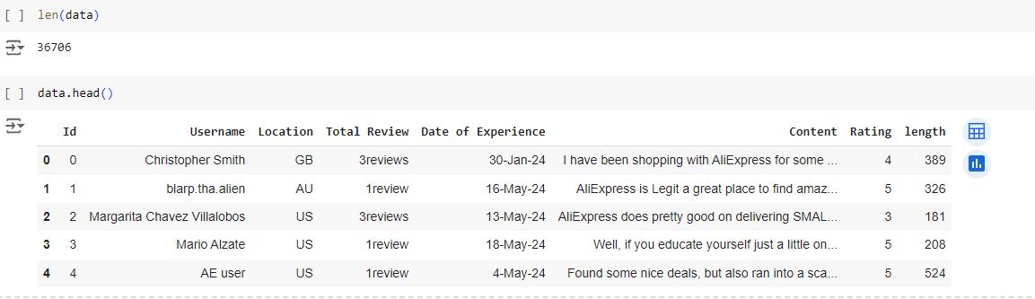
Data Cleaning
The dataset consists of 46,100 rows and 7 columns. Below rows with missing information were removed.
Dataset after missing values are removed

Slide 6
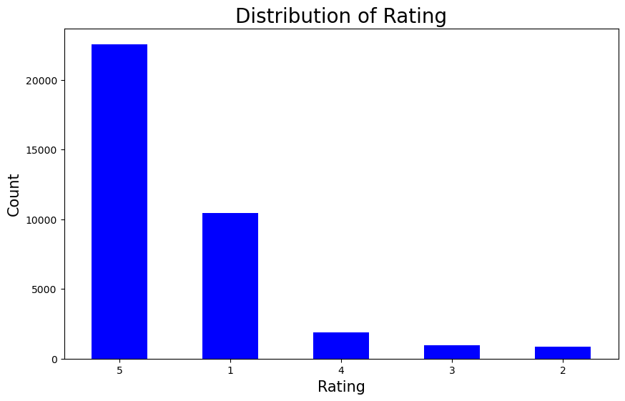
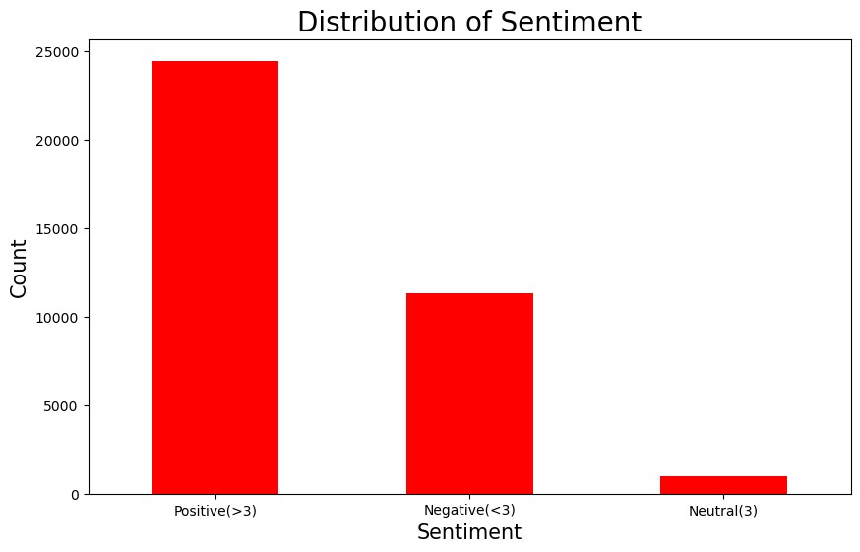
Exploratory Data Analysis

Slide 7
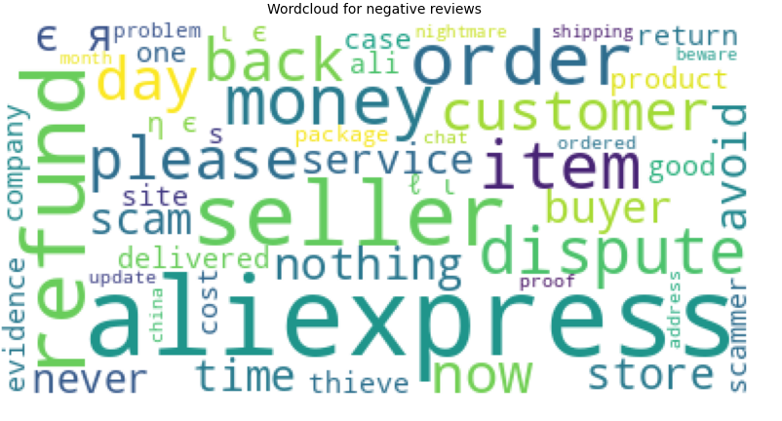
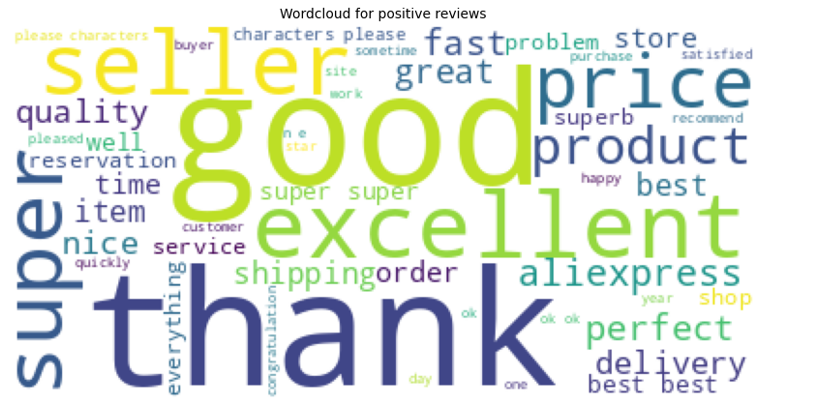
Word distribution
Negative Reviews
Positive Reviews

Slide 8
Text Preprocessing
This is essentially, preparing text input to be machine-readable, removing all unnecessary words and converting words to the root base(lemmatization).
Converting to lowercase
Removing URL links
Removing special characters
Stop words removal
Tokenization ( breaking sentences into single units of words)
Lemmatization (converting words to its root base e.g. “running to run”)

Slide 9
Model Selection
This section details the training and selection process for sentiment analysis models in this project. The goal is to identify the model that best classifies text data as positive, negative, or neutral.
Evaluated Models:
Lexicon-Based Model: Vader Sentiment Analyzer (Vader)
Machine Learning Models:
Logistic Regression (LR)
Support Vector Classifier (SVC)
Naive Bayes (NB)

Slide 10
Evaluation Metrics
 | Accuracy | Weighted avg. Precision | Weighted avg. recall | Weighted avg. F1-score
Naïve - Bayes | 79% | 84% | 80% | 80%
Logistic Regression | 87% | 90% | 88% | 89%
Support Vector Classifier | 90% | 90% | 89% | 90%
Given the nature of the dataset, where there is a significant imbalance, we utilised weighted F1-Score to choose the best performing model which is SVC.

Slide 11
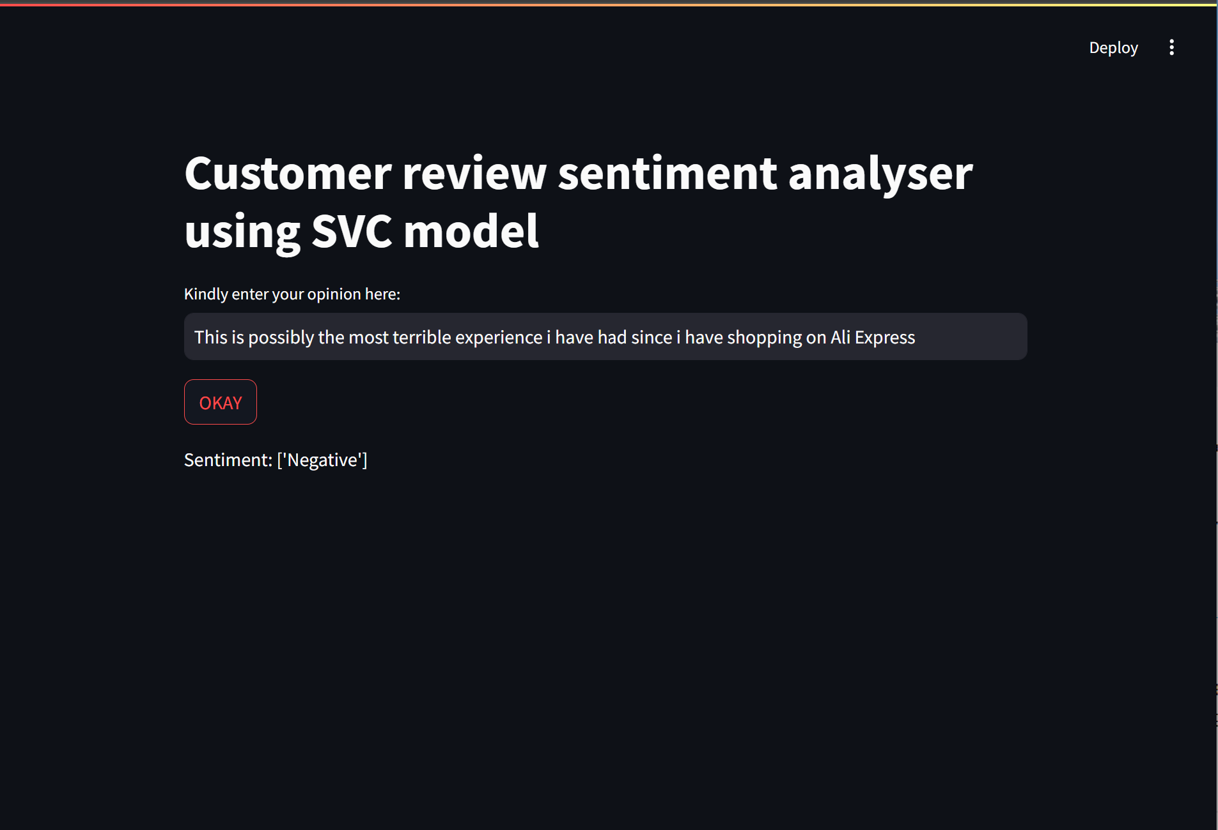
Model deployment
Streamlit interface: The Interface accepts single and multiple text input for analysis.
Option to download results of multiple Texts and a visualization of the results of the Analysis.

Slide 12
Business Impact
Increased Customer Satisfaction and Retention:
This project allows Ali Express to identify customer pain points and dissatisfaction expressed through reviews. By addressing these concerns promptly and effectively, the company can reduce churn rate and increase customer satisfaction score (CSAT)
Enhanced Product Development and Innovation:
Proactively analyzing customer sentiment regarding existing products and features will assist in identifying areas for improvement and gathering suggestions for new features. This can result in:
-Reduced development costs: Prioritize development efforts based on actual customer needs, avoiding investment in features that might not be desired.
-Increased product adoption: Develop products that cater to customer preferences, leading to higher adoption rates and market share.
Streamlined Customer Service:
This will help address frequently encountered customer issues proactively, streamlining customer service interactions. It also helps Identify areas where customer service agents need additional training based on the sentiment analysis.

Slide 13
Competitive Advantage:
Proactively analyzing customer sentiment towards the company’s competitors helps identify areas where differences can be made to improve customer experience.
-Developing unique selling propositions (USPs): Highlight aspects of the company’s product or service that customers value and competitors lack.
-Gaining market share: Attract customers who are dissatisfied with competitors' offerings by showcasing Ali Express brand's strengths.

Slide 14
Conclusion
By actively analyzing and utilizing customer sentiment data, Ali Express can make data-driven decisions that positively impact your business across various aspects. It is also important to track the below metrics over time.
Customer Satisfaction Scores (CSAT): Monitor changes in CSAT after implementing improvements based on sentiment analysis.
Customer Churn Rate: Track if the churn rate decreases after addressing customer concerns identified through sentiment analysis.
Marketing Campaign Performance: Analyze changes in conversion rates or click-through rates after sentiment-based adjustments to marketing campaigns.
Customer Service Resolution Time: Monitor if sentiment analysis helps identify and address customer issues quicker.

Slide 15
Any Questions?

